Slide 1
Fire Service
Districts
November 11, 2024
Collin County Commissioners Court

Slide 2
Collin County
Fire Services Agreements
October 1, 2013
Originally signed Fire Services Agreements
2013 Population
37,468
in unincorporated Collin County (no MUDs)
2023 Population
55,207
in unincorporated Collin County (no MUDs)

Slide 3
Collin County
Fire Services Agreements
Annual County funds
$950,000
Dispatch subsidy
$980,975
To fire departments for dispatch services
Cities Contracted
21 cities
To cover Fire Districts
MUDs are not included
AMR provides EMS (8 cities)
City of Princeton is holder of AMR contract County spent $379,444 in FY 2024

Slide 4
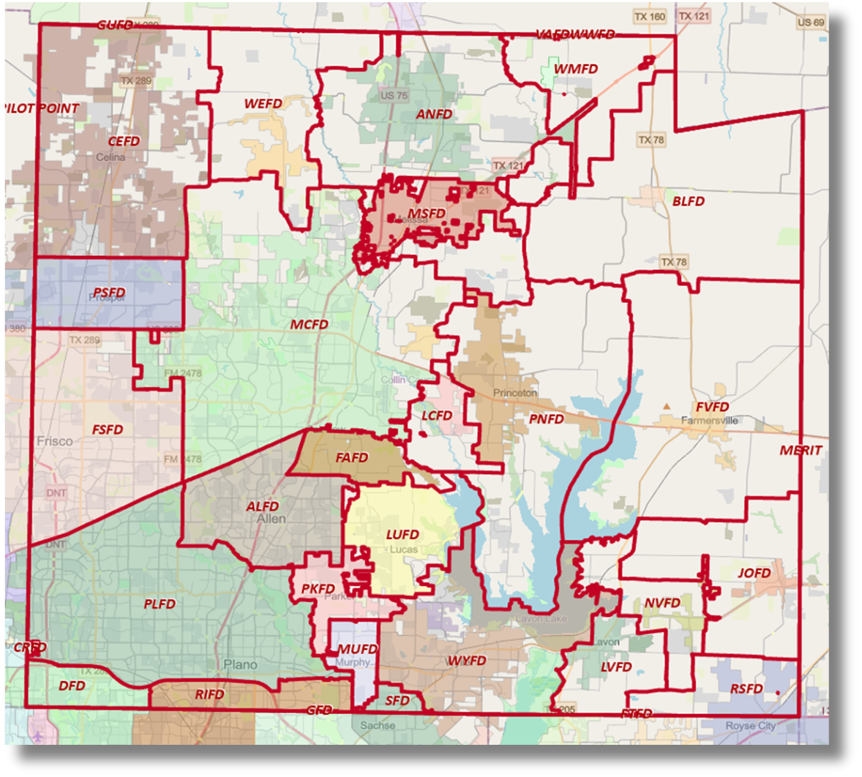
Fire Department Boundary Map

Slide 5
Why did we enter into fire service agreements?
Sec. 352.001, Tex. Local Gov’t Code:
“The Commissioners Court of a county may furnish fire protection or fire-fighting equipment to the residents of the county…”
Collin County does NOT have a fire department.

Slide 6
Why did we enter into fire service agreements?
Safety and Protection
Protect lives and property
Preventing Property Loss
Mitigate damage and potentially save properties from being completely lost.
Wildfire/Grassfire Management
Control wildfires/grassfires to minimize impact on homes and businesses.
Community Development
Make unincorporated areas more attractive for residents and businesses, encouraging growth and development.
Regulatory Compliance
Regulations requiring fire protection services for insurance purposes and public safety standards.

Slide 7
Cities have terminated the agreement
October 1, 2013
22 cities
Agreement originally signed
October 1, 2024
21 cities
City of Melissa no longer contracted
City of Weston covering Melissa’s
fire district
October 1, 2025
19 cities
City of McKinney and City of Farmersville no longer contracted

Slide 8
Future Options
Increase contract amount with the Cities (currently $950,000)
Emergency Services District (ESD)
County Assistance District (CAD)

Slide 9
Increase Contract Amount with Cities
Current County Subsidy
McKinney
$120 per call
$597 per call for fire
Farmersville
$400 per call
$216 for fire
$184 for dispatch subsidy
City of Wylie letter dated Nov. 4, 2024 to renegotiate contract.
Issue: cost per run varies among cities McKinney - $2,200
Farmersville - $710 Wylie - $2,340
Comes out of General Fund

Slide 10
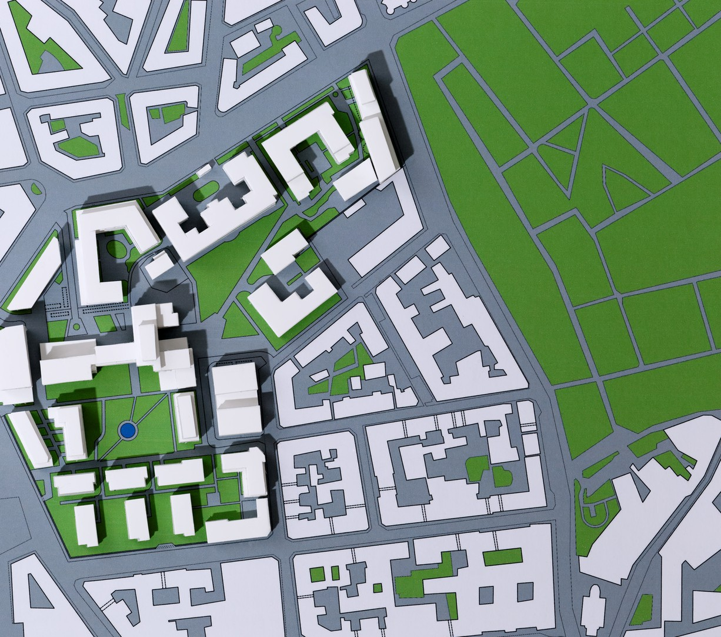
Emergency Services District
Texas Constitution, Article 3, Section 48-e
Health and Safety Code Chapter 775 Petition with metes and bounds description of the district signed by 100 eligible residents
Commissioners Court receives and calls the election
Cities have 60 days to determine if ETJ is included in the ESD
Existing MUDs, if included in the petition, can be part of the ESD

Slide 11
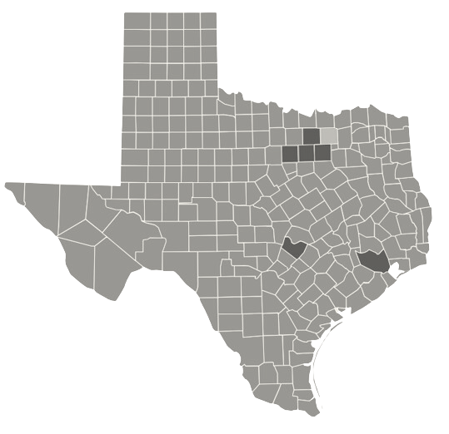
OTHER COUNTIES
PARKER
TARRANT
8 ESDs
1 ESD
HARRIS
DENTON
32 ESDs
2 ESDs
TRAVIS
DALLAS
17 ESDs
County contracts with cities
and a volunteer fire
department

Slide 12
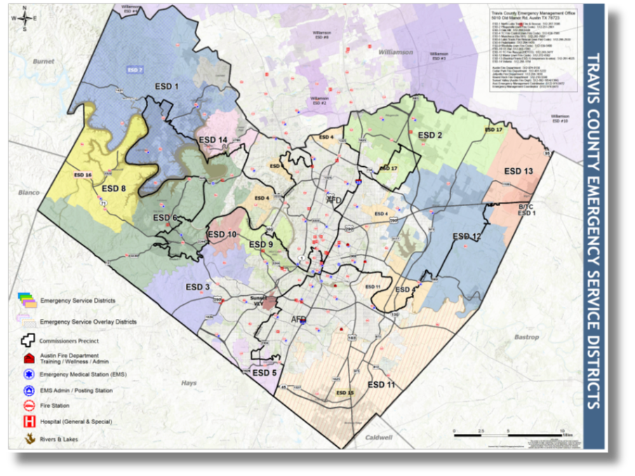
Travis County ESD Map

Slide 13
Emergency Services District
TY 24 - ESD Property Tax Levy
 |  | 2024 Taxable Value | $0.05 Rate | $0.025 Rate
Collin Co MUDs | $ | 6,544,367,805 | $ 3,272,184 | $ 1,636,092
Unincorporated (No ETJ/MUDs) | $ | 3,347,983,283 | $ 1,673,992 | $ 836,996
City Extraterritorial Jurisdictions (ETJ) | $ | 13,314,082,127 | $ 6,657,041 | $ 3,328,521
 | $ | 23,206,433,215 | $ 11,603,217 | $ 5,801,608
Above demonstrates the range of possible ESD levy. If all cities allow their ETJ to be included in the ESD boundaries and MUDs are part of the ESD, there is $23.2 billion in taxable value. If all cities do not allow their ETJs to be included in the ESD boundaries, the lowest taxable value is
$3.3 billion.
Additionally, ESD voters can approve up to a two (2) cent sales tax in the unincorporated area.

Slide 14
Emergency Services District
Governance
Current Statute: Commissioners Court appoints member to two (2) year terms
Legislative change in order to:
Allow ESD board members to be elected
Create statutory bracket to allow Commissioners Court members to serve as ESD Board of Commissioners

Slide 15
County Assistance District
(CAD)
Local Gov’t Code Chapter 387
County Commissioners Court calls a vote and voters create the district
County sales tax (up to 2%)
Currently working with Comptroller’s Office on sales tax revenue in unincorporated

Slide 16
Court Consideration
Fire Service Strategy
Negotiate with current cities to cover all fire districts Increase contract amount
Create a county fire department
ESD or CAD
Level of Court and Staff Engagement
ESD

Slide 17
Questions?

